Slide 1
Roller Coaster History

Slide 2
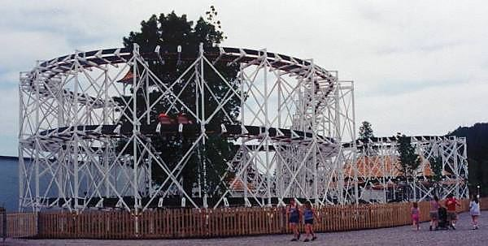
1902
In Pennsylvania, the oldest ride currently operating, the Leaps-the-Dips, opens

Slide 3
1924
The Giant Dipper opens at Santa Cruz, CA
one of Ms. Reinders’ favorites!

Slide 4
Roller Coaster Elements

Slide 5
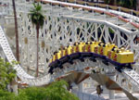
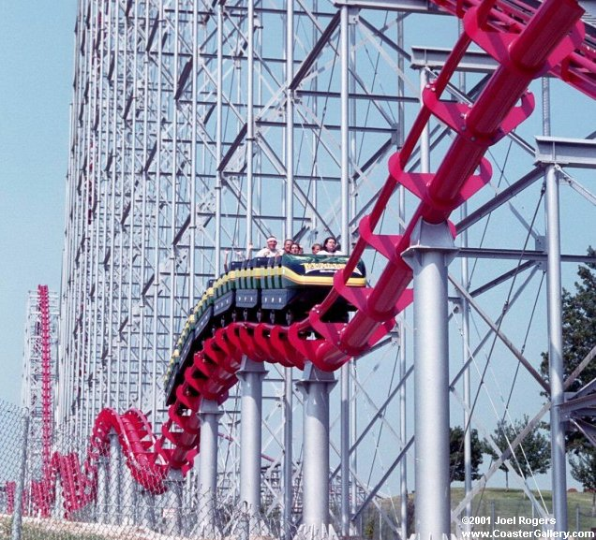
Camelback
Found on Various Types of Roller Coasters
Description: Two or more consecutive bunny hops

Slide 6
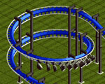
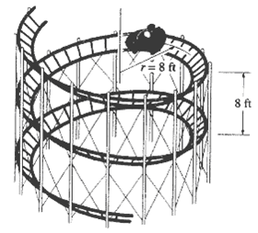
Helix
Found on Various Types of Roller Coasters
Description: Ascending or descending continuous curve of constant radius

